Slide 1
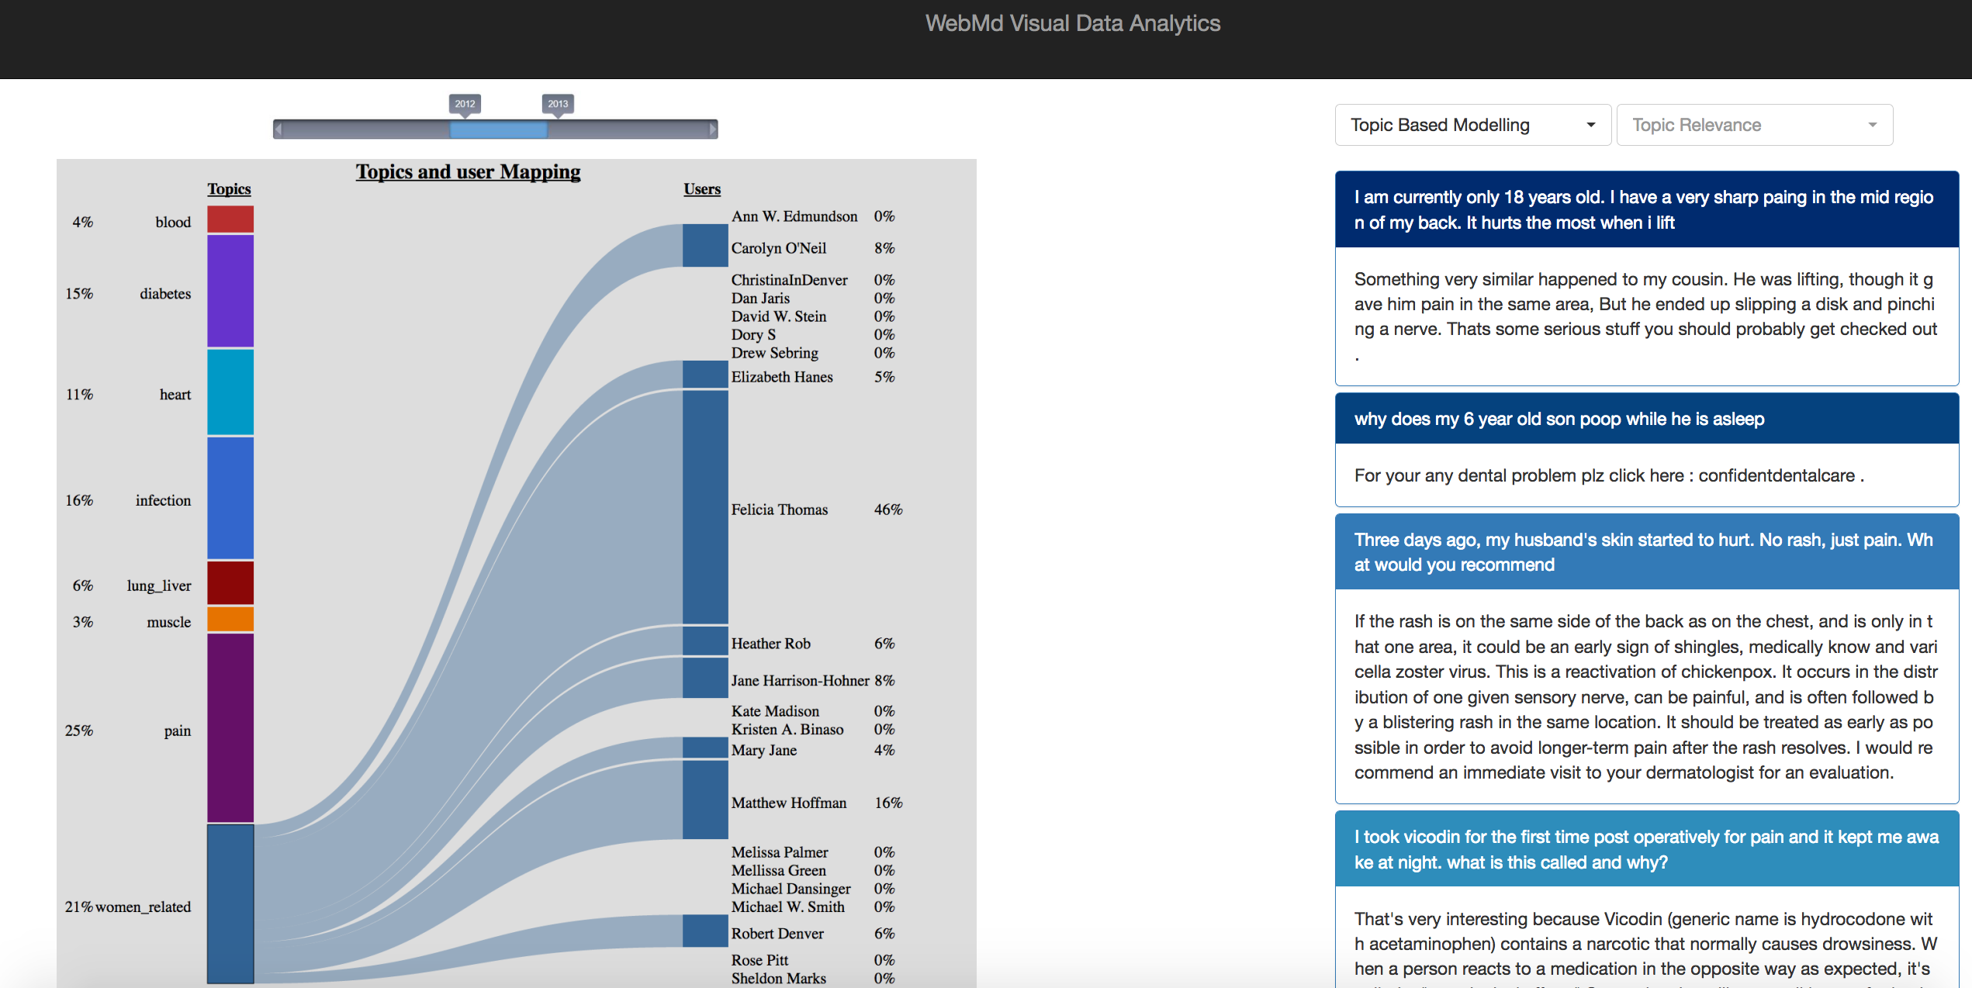
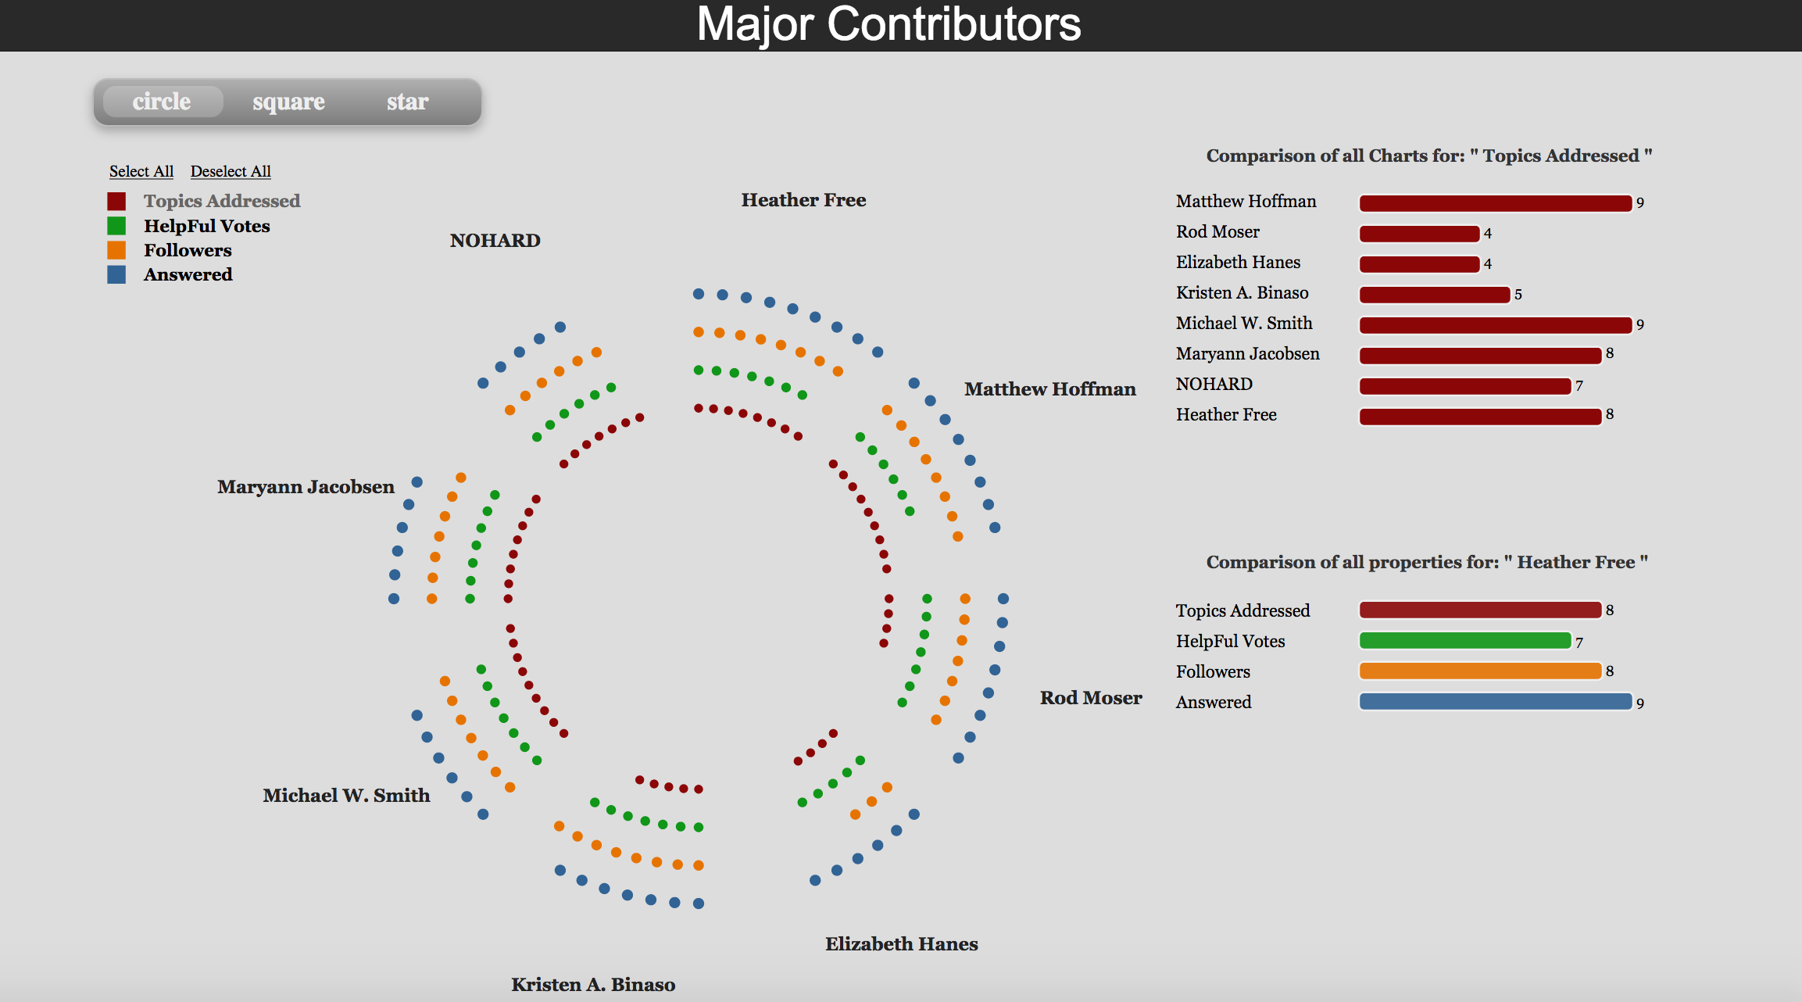
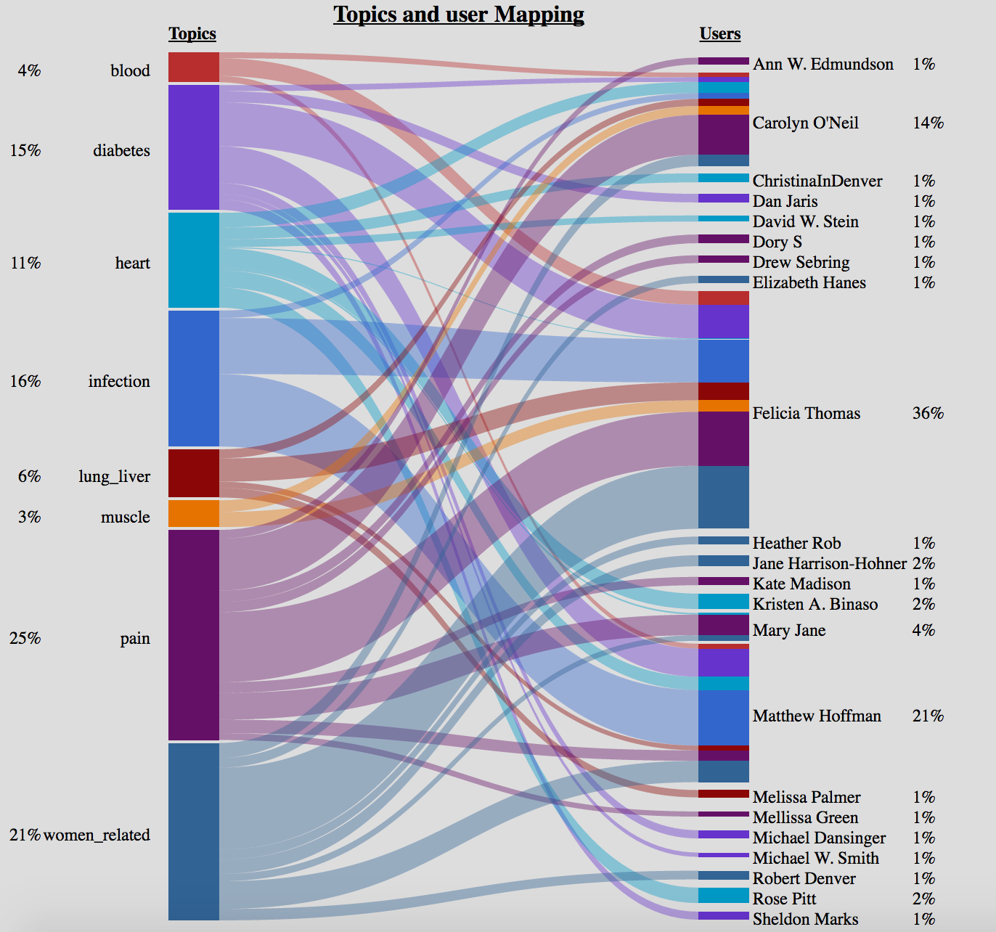
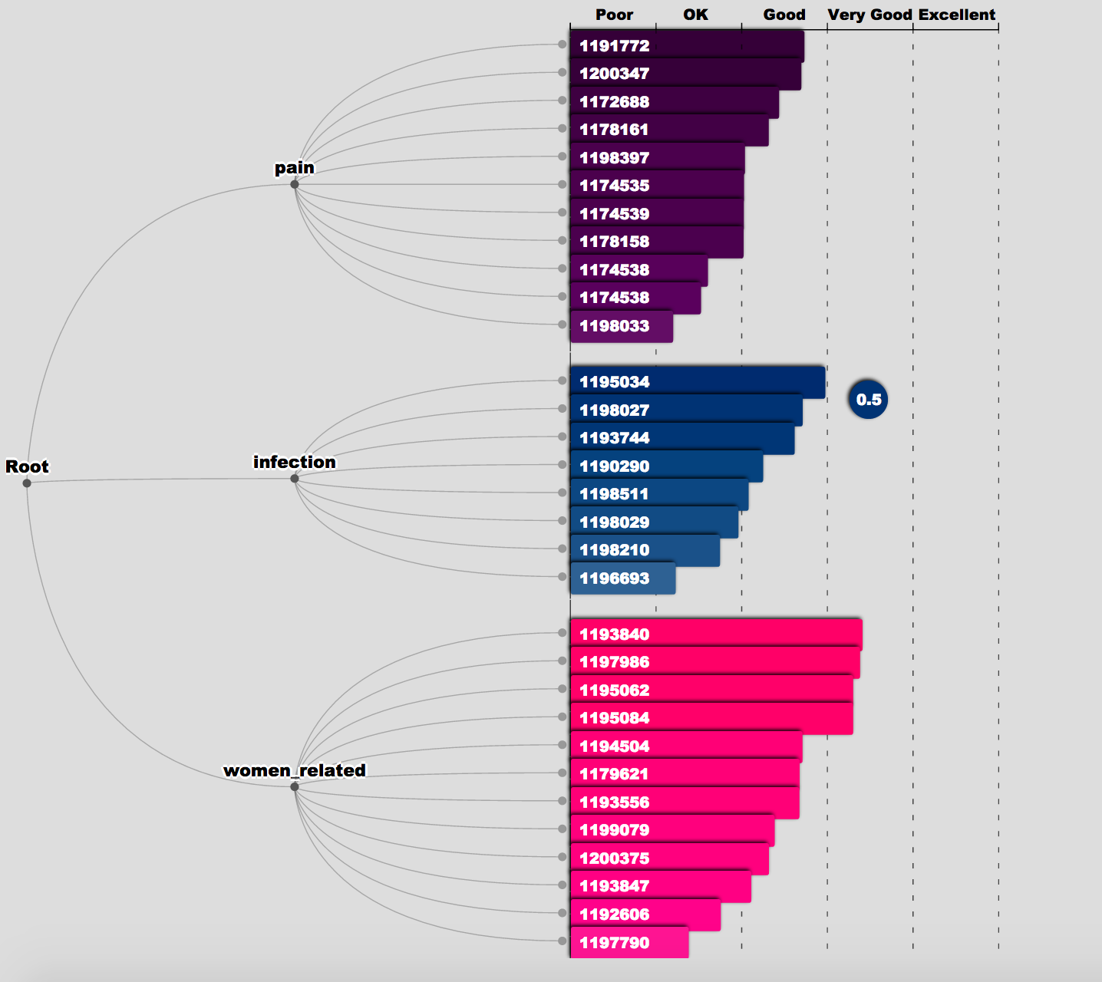
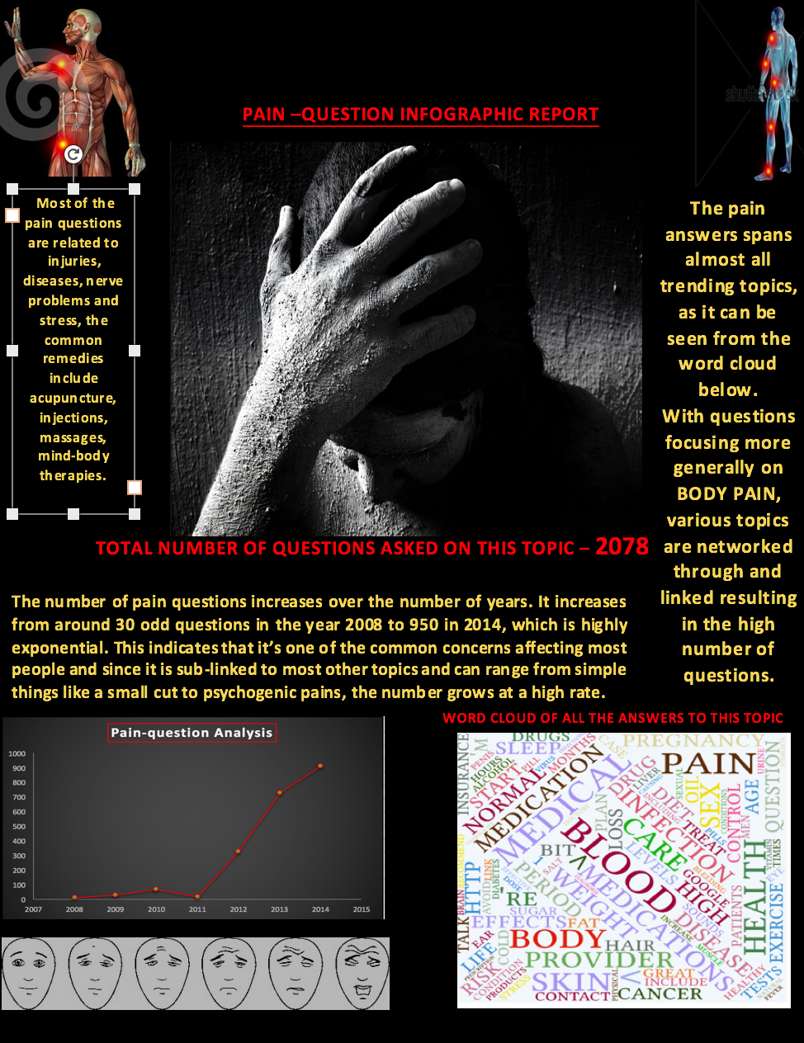
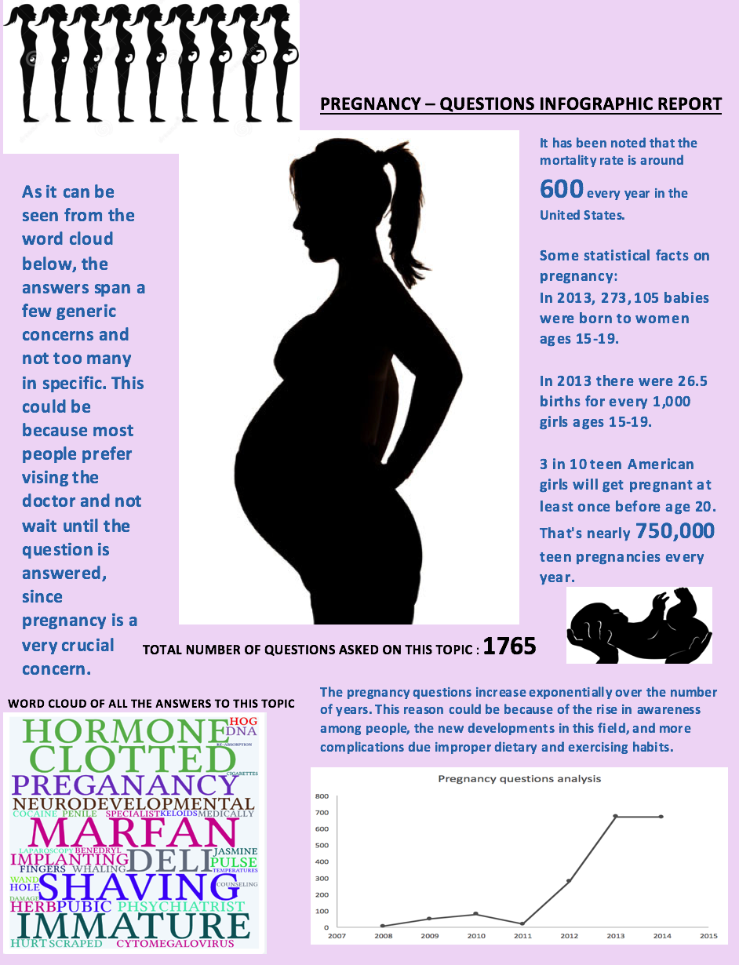
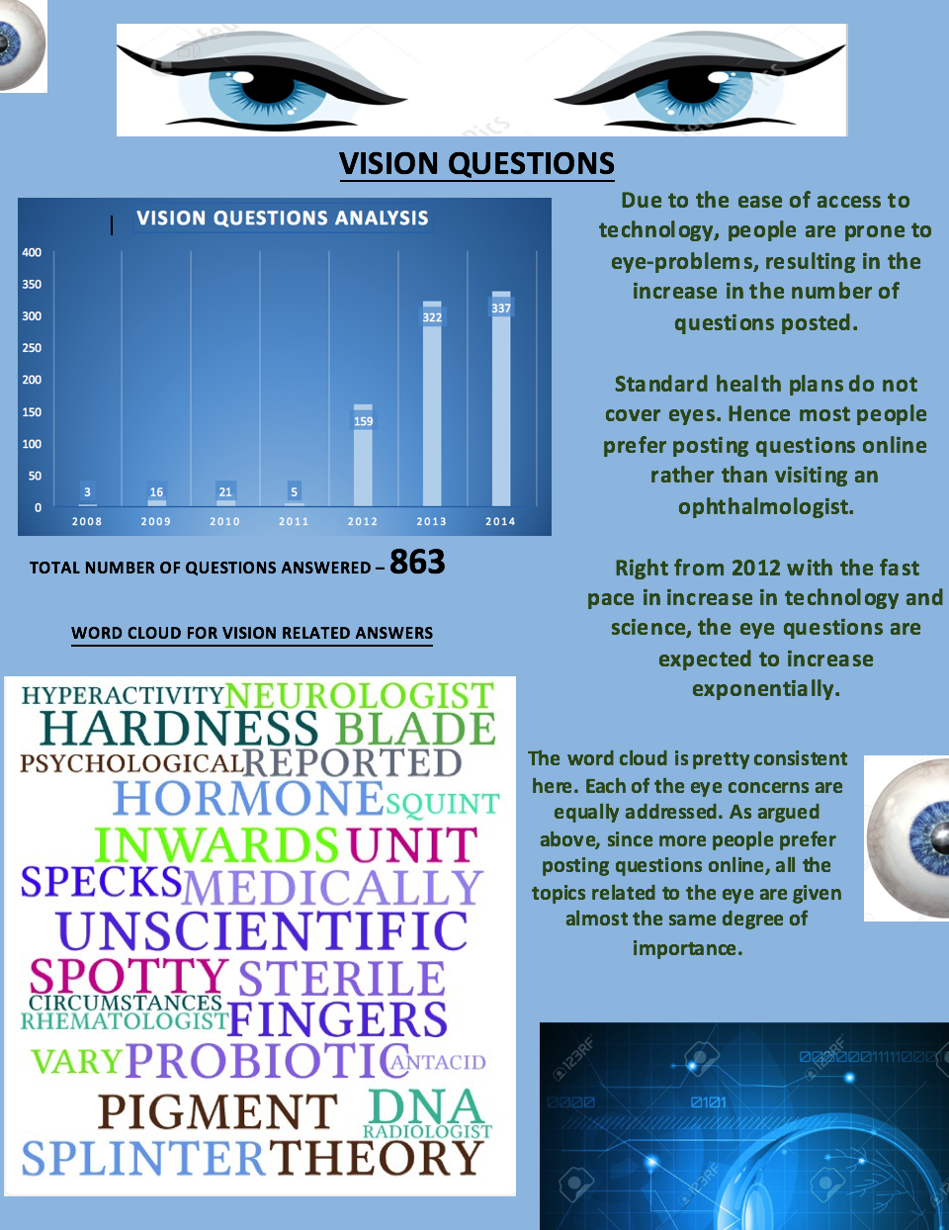
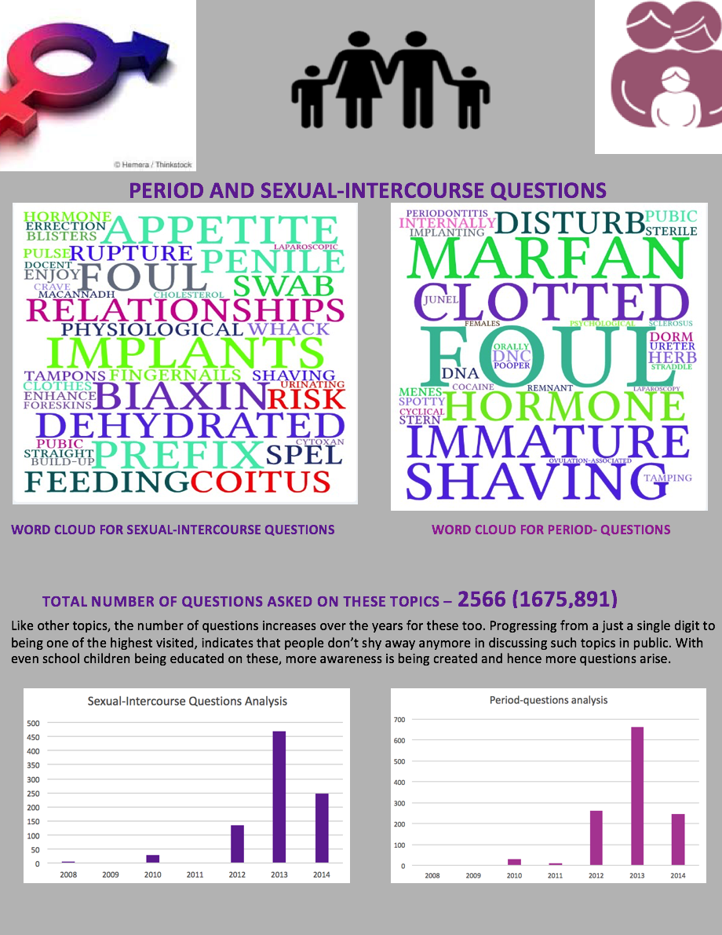
TOPIC BASED-VISUALIZATION
USER BASED-VISUALIZATION
Topic User Mapping
This visualization maps the eight generalized topics and its associated users. It mainly depicts how much a person knows about the topics he/she has addressed.
Clicking on each of the topics gives a percentage mapping to it's proficient users. This percentage is obtained depending on the number of helpful votes. Clicking on the user gives a percentage mapping of how much he/she is proficient among the selected topics.
Interpretation of the chart
The above visualization represents the contributions of the top eight experts/users of the website filtered mainly on the number of helpful votes. Each pie of the chart describes the attributes of a particular user. The number indicating the rating is on the scale of 1 to 10.
About the chart
When the attributes are individually selected, the first relative comparison on the right side, compares all the eight users on this attribute. On clicking the names, the second comparison represents all the four attributes of only the selected user.
In this project , we propose a semantic visual analytic system to explore online Q/A Forum WebMD. This Visual Analytic System delivers conversation mining technique with an interactive visualization to presents a unique way of understanding the semantics of the questions asked , answer posted ,and the users associated. We have considered three types of visualizations based on topic, users and sentiments. We make use of topic modeling approach such as Latent Dirichlet Association and Topic Facet Modelling
to derive topics from questions and answers. These topics are visualized with the questions associated with them quantifying the measure of coherence between a question and the topics.
Topic Question Relevance
INFOGRAPHIC REPORTS
The given chart represents the relevance of the question to it's topic. We have scaled the value from 0(not at all related) to 1(very much related).
The length of the individual bar represents the measure of coherence with its topic and the intensity of the color represents the popularity of the question.
Above are the infographic reports generated for the most popular topics of discussion. Each of these reports contain a chart depicting the popularity of the topics over the years. It also contains a word cloud of all the answers related to that topic. Based on this information few facts and conclusions have been stated.

